Slide 1
Multiple Regression
Analysis: Inference

Slide 2
Multiple Regression
Analysis: Inference
Statistical inference in the regression model
  Hypothesis tests about population parameters
  Construction of confidence intervals
Sampling distributions of the OLS estimators
  The OLS estimators are random variables
  We already know their expected values and their variances
  However, for hypothesis tests we need to know their distribution
  In order to derive their distribution we need additional assumptions
  Assumption about distribution of errors: normal distribution

Slide 3


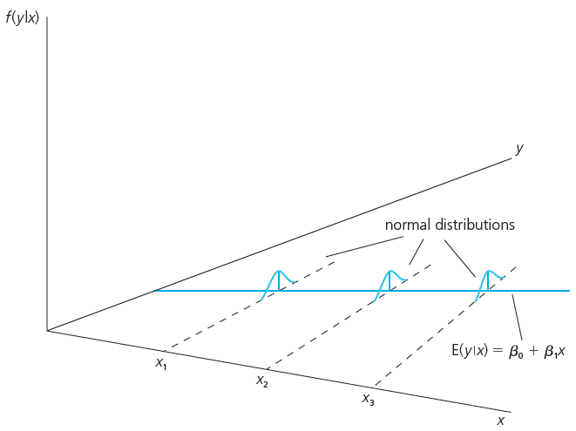
Multiple Regression
Analysis: Inference
Assumption MLR.6 (Normality of error terms)
independently of
It is assumed that the unobserved
factors are normally distributed around the population regression function.
The form and the variance of the distribution does not depend on
any of the explanatory variables.
It follows that:

Slide 4
Multiple Regression
Analysis: Inference
Discussion of the normality assumption
  The error term is the sum of “many” different unobserved factors
  Sums of independent factors are normally distributed (CLT)
  Problems:
    How many different factors? Number large enough?
    Possibly very heterogenuous distributions of individual factors
    How independent are the different factors?
  The normality of the error term is an empirical question
  At least the error distribution should be “close” to normal
  In many cases, normality is questionable or impossible by definition

Slide 5
Multiple Regression
Analysis: Inference
Discussion of the normality assumption (cont.)
  Examples where normality cannot hold:
    Wages (nonnegative; also: minimum wage)
    Number of arrests (takes on a small number of integer values)
    Unemployment (indicator variable, takes on only 1 or 0)
  In some cases, normality can be achieved through transformations of the dependent variable (e.g. use log(wage) instead of wage)
  Under normality, OLS is the best (even nonlinear) unbiased estimator
  Important: For the purposes of statistical inference, the assumption of normality can be replaced by a large sample size

Slide 6




Multiple Regression
Analysis: Inference
Terminology
Theorem 4.1 (Normal sampling distributions)
“Gauss-Markov assumptions”
“Classical linear model (CLM) assumptions”
Under assumptions MLR.1 – MLR.6:
The estimators are normally distributed around the true parameters with the variance that was derived earlier
The standardized estimators follow a standard normal distribution

Slide 7
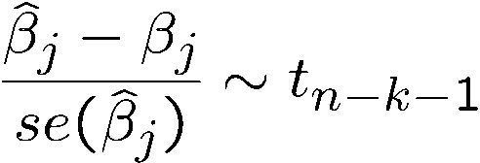

Multiple Regression
Analysis: Inference
Testing hypotheses about a single population parameter
Theorem 4.2 (t-distribution for the standardized estimators)
Null hypothesis (for more general hypotheses, see below)
Under assumptions MLR.1 – MLR.6:
If the standardization is done using the estimated standard deviation (= standard error), the normal distribution is replaced by a t-distribution
Note: The t-distribution is close to the standard normal distribution if n-k-1 is large.
The population parameter is equal to zero, i.e. after controlling for the other independent variables, there is no effect of x_{j} on y

Slide 8


Multiple Regression
Analysis: Inference
t-statistic (or t-ratio)
Distribution of the t-statistic if the null hypothesis is true
Goal: Define a rejection rule so that, if it is true, H0 is rejected only with a small probability (= significance level, e.g. 5%)
The t-statistic will be used to test the above null hypothesis. The farther the estimated coefficient is away from zero, the less likely it is that the null hypothesis holds true. But what does “far” away from zero mean?
This depends on the variability of the estimated coefficient, i.e. its standard deviation. The t-statistic measures how many estimated standard deviations the estimated coefficient is away from zero.

Slide 9
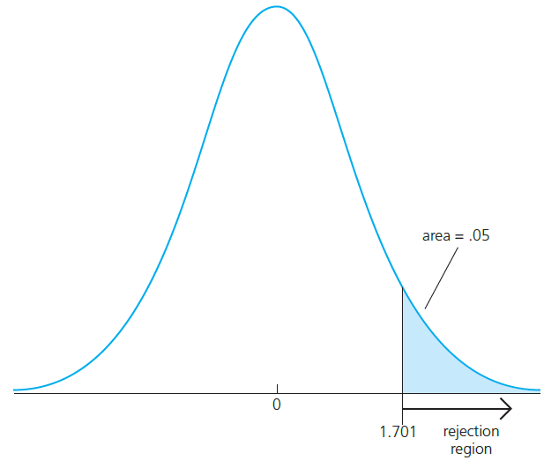


Multiple Regression
Analysis: Inference
Testing against one-sided alternatives (greater than zero)
Test against .
Reject the null hypothesis in favour of the alternative hypothesis if the estimated coef-
ficient is “too large” (i.e. larger than a criti-
cal value).
Construct the critical value so that, if the
null hypothesis is true, it is rejected in,
for example, 5% of the cases.
In the given example, this is the point of the t-distribution with 28 degrees of freedom that is exceeded in 5% of the cases.
Reject if t-statistic is greater than 1.701

Slide 10



Multiple Regression
Analysis: Inference
Example: Wage equation
  Test whether, after controlling for education and tenure, higher work experience leads to higher hourly wages
Standard errors
Test against .
One would either expect a positive effect of experience on hourly wage or no effect at all.

Slide 11


Multiple Regression
Analysis: Inference
Example: Wage equation (cont.)
t-statistic
Degrees of freedom;
here the standard normal
approximation applies
Critical values for the 5% and the 1% significance level (these are conventional significance levels).
The null hypothesis is rejected because the t-statistic exceeds the critical value.
“The effect of experience on hourly wage is statistically greater than zero at the 5% (and even at the 1%) significance level.”

Slide 12
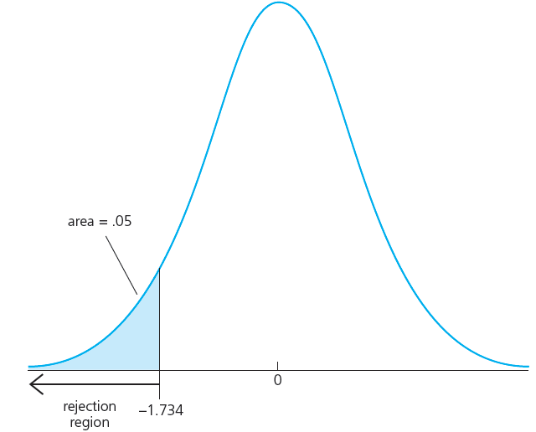

Multiple Regression
Analysis: Inference
Testing against one-sided alternatives (less than zero)
Test against .
Reject the null hypothesis in favour of the alternative hypothesis if the estimated coef-
ficient is “too small” (i.e. smaller than a criti-
cal value).
Construct the critical value so that, if the
null hypothesis is true, it is rejected in,
for example, 5% of the cases.
In the given example, this is the point of the t-distribution with 18 degrees of freedom so that
5% of the cases are below the point.
Reject if t-statistic is less than -1.734

Slide 13



Multiple Regression
Analysis: Inference
Example: Student performance and school size
  Test whether smaller school size leads to better student performance
Percentage of students
passing maths test
Average annual tea-
cher compensation
Staff per one thou-sand students
Student enrollment
(= school size)
Test against .
Do larger schools hamper student performance or is there no such effect?

Slide 14


Multiple Regression
Analysis: Inference
Example: Student performance and school size (cont.)
t-statistic
Degrees of freedom;
here the standard normal
approximation applies
Critical values for the 5% and the 15% significance level.
The null hypothesis is not rejected because the t-statistic is not smaller than the critical value.
One cannot reject the hypothesis that there is no effect of school size on student performance (not even for a lax significance level of 15%).

Slide 15
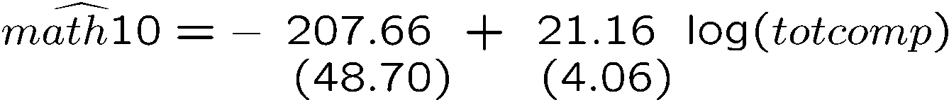




Multiple Regression
Analysis: Inference
Example: Student performance and school size (cont.)
  Alternative specification of functional form:
R-squared slightly higher
Test against .

Slide 16
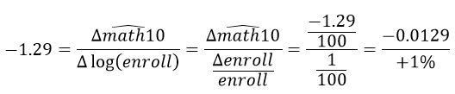
Multiple Regression
Analysis: Inference
Example: Student performance and school size (cont.)
t-statistic
Critical value for the 5% significance level; reject null hypothesis
The hypothesis that there is no effect of school size on student performance can be rejected in favor of the hypothesis that the effect is negative.
How large is the effect?
+ 10% enrollment ; -0.129 percentage points students pass test
(small effect)

Slide 17
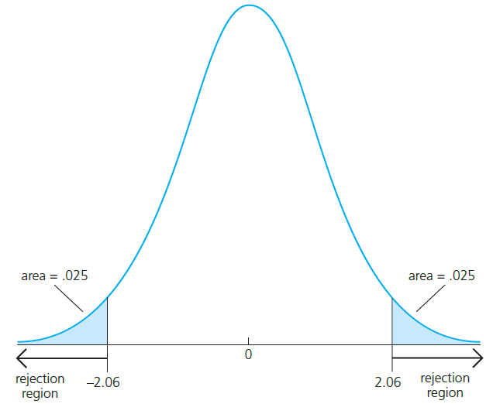

Multiple Regression
Analysis: Inference
Testing against two-sided alternatives
Test against .
Reject the null hypothesis in favour of the alternative hypothesis if the absolute value
of the estimated coefficient is too large.
Construct the critical value so that, if the
null hypothesis is true, it is rejected in,
for example, 5% of the cases.
In the given example, these are the points
of the t-distribution so that 5% of the cases
lie in the two tails.
Reject if absolute value of t-statistic is less than -2.06 or greater than 2.06

Slide 18

Multiple Regression
Analysis: Inference
Example: Determinants of college GPA
Lectures missed per week
For critical values, use standard normal distribution
The effects of hsGPA and skipped are significantly different from zero at the 1% significance level. The effect of ACT is not significantly different from zero, not even at the 10% significance level.

Slide 19



Multiple Regression
Analysis: Inference
“Statistically significant” variables in a regression
  If a regression coefficient is different from zero in a two-sided test, the corresponding variable is said to be “statistically significant”
  If the number of degrees of freedom is large enough so that the normal approximation applies, the following rules of thumb apply:
“statistically significant at 10% level”
“statistically significant at 5% level”
“statistically significant at 1% level”

Slide 20

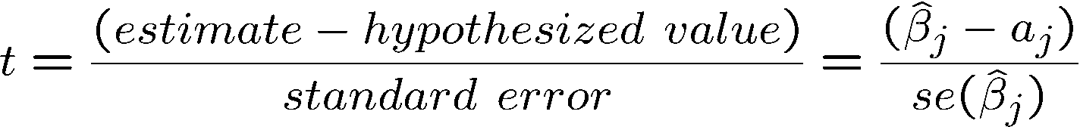
Multiple Regression
Analysis: Inference
Testing more general hypotheses about a regression coefficient
Null hypothesis
t-statistic
The test works exactly as before, except that the hypothesized value is substracted from the estimate when forming the statistic
Hypothesized value of the coefficient

Slide 21
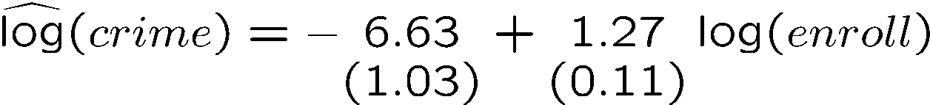

Multiple Regression
Analysis: Inference
Example: Campus crime and enrollment
  An interesting hypothesis is whether crime increases by one percent if enrollment is increased by one percent
Estimate is different from one but is this difference statistically significant?
The hypothesis is rejected at the 5% level

Slide 22
Multiple Regression
Analysis: Inference
Computing p-values for t-tests
  If the significance level is made smaller and smaller, there will be a point where the null hypothesis cannot be rejected anymore
  The reason is that, by lowering the significance level, one wants to avoid more and more to make the error of rejecting a correct H₀
  The smallest significance level at which the null hypothesis is still rejected, is called the p-value of the hypothesis test
  A small p-value is evidence against the null hypothesis because one would reject the null hypothesis even at small significance levels
  A large p-value is evidence in favor of the null hypothesis
  P-values are more informative than tests at fixed significance levels

Slide 23
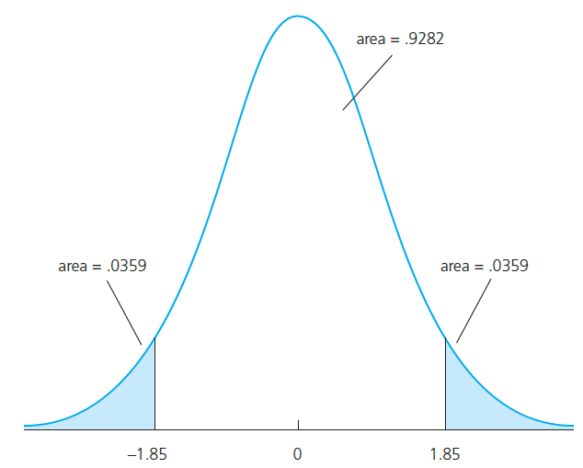
Multiple Regression
Analysis: Inference
How the p-value is computed (here: two-sided test)?
The p-value is the significance level at which one is indifferent between rejecting and not rejecting the null hypothesis.
In the two-sided case, the p-value is thus the probability that the t-distributed variable takes on a larger absolute value than the realized value of the test statistic, e.g.:
From this, it is clear that a null hypothesis is rejected if and only if the corresponding p-value is smaller than the significance level.
For example, for a significance level of 5% the t-statistic would not lie in the rejection region.
These would be the critical values for a 5% significance level
value of test statistic

Slide 24
Multiple Regression
Analysis: Inference
Guidelines for discussing economic and statistical significance
  If a variable is statistically significant, discuss the magnitude of the coefficient to get an idea of its economic or practical importance
  The fact that a coefficient is statistically significant does not necessarily mean it is economically or practically significant!
  If a variable is statistically and economically important but has the “wrong” sign, the regression model might be misspecified
  If a variable is statistically insignificant at the usual levels (10%, 5%, or 1%), one may think of dropping it from the regression
  If the sample size is small, effects might be imprecisely estimated so that the case for dropping insignificant variables is less strong

Slide 25
Multiple Regression
Analysis: Inference
Critical value of
two-sided test
Confidence intervals
Simple manipulation of the result in Theorem 4.2 implies that
Interpretation of the confidence interval
  The bounds of the interval are random
  In repeated samples, the interval that is constructed in the above way will cover the population regression coefficient in 95% of the cases
Lower bound of the
Confidence interval
Upper bound of the
Confidence interval
Confidence level

Slide 26



Multiple Regression
Analysis: Inference
Confidence intervals for typical confidence levels
Relationship between confidence intervals and hypotheses tests
Use rules of thumb
reject in favor of

Slide 27



Multiple Regression
Analysis: Inference
Example: Model of firms‘ R&D expenditures
Spending on R&D
Annual sales
Profits as percentage of sales
The effect of sales on R&D is relatively precisely estimated as the interval is narrow. Moreover, the effect is significantly different from zero because zero is outside the interval.
This effect is imprecisely estimated as the in-
terval is very wide. It is not even statistically
significant because zero lies in the interval.

Slide 28


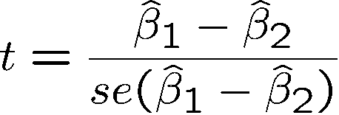
Multiple Regression
Analysis: Inference
Testing hypotheses about a linear combination of the parameters
Example: Return to education at two-year vs. at four-year colleges
Years of education at two year colleges
Years of education at four year colleges
Months in the workforce
Test against .
A possible test statistic would be:
The difference between the estimates is normalized by the estimated standard deviation of the difference. The null hypothesis would have to be rejected if the statistic is “too negative” to believe that the true difference between the parameters is equal to zero.

Slide 29



Multiple Regression
Analysis: Inference
Impossible to compute with standard regression output because
Alternative method
Usually not available in regression output
Define and test against .
Insert into original regression
a new regressor (= total years of college)

Slide 30

Multiple Regression
Analysis: Inference
Estimation results
This method works always for single linear hypotheses
Total years of college
Hypothesis is rejected at 10% level but not at 5% level

Slide 31

Multiple Regression
Analysis: Inference
Testing multiple linear restrictions: The F-test
Testing exclusion restrictions
Salary of major lea-
gue baseball player
Years in
the league
Average number of
games per year
Batting average
Home runs per year
Runs batted in per year
against
Test whether performance measures have no effect/can be excluded from regression.

Slide 32
Multiple Regression
Analysis: Inference
Estimation of the unrestricted model
None of these variabels is statistically significant when tested individually
Idea: How would the model fit be if these variables were dropped from the regression?

Slide 33
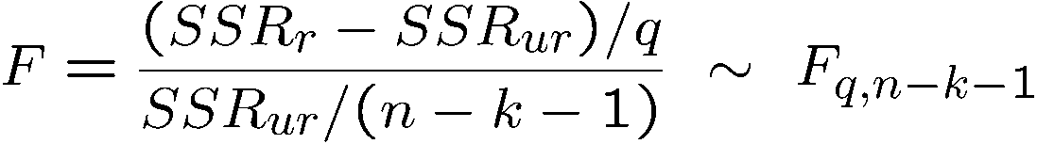
Multiple Regression
Analysis: Inference
Estimation of the restricted model
Test statistic
The sum of squared residuals necessarily increases, but is the increase statistically significant?
Number of restrictions
The relative increase of the sum of squared residuals when going from
H₁ to H₀ follows a F-distribution (if
the null hypothesis H₀ is correct)

Slide 34
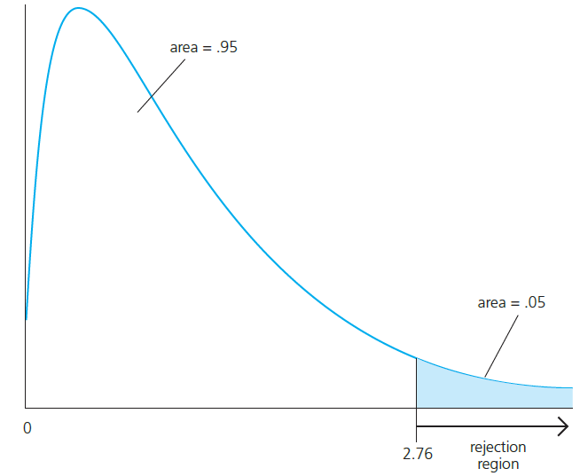
Multiple Regression
Analysis: Inference
Rejection rule
A F-distributed variable only takes on positive values. This corresponds to the fact that the sum of squared residuals can only increase if one moves from H₁ to H₀.
Choose the critical value so that the null hypo-thesis is rejected in, for example, 5% of the cases, although it is true.

Slide 35
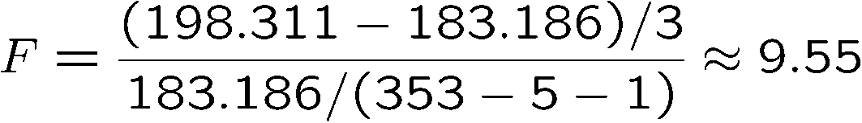
Multiple Regression
Analysis: Inference
Test decision in example
Discussion
  The three variables are “jointly significant”
  They were not significant when tested individually
  The likely reason is multicollinearity between them
Number of restrictions to be tested
Degrees of freedom in
the unrestricted model
The null hypothesis is overwhel-mingly rejected (even at very small significance levels).

Slide 36

Multiple Regression
Analysis: Inference
Test of overall significance of a regression
The test of overall significance is reported in most regression packages; the null hypothesis is usually overwhelmingly rejected
The null hypothesis states that the explanatory variables are not useful at all in explaining the dependent variable
Restricted model
(regression on constant)

Slide 37

Multiple Regression
Analysis: Inference
Testing general linear restrictions with the F-test
Example: Test whether house price assessments are rational
Actual house price
The assessed housing value (before the house was sold)
Size of lot
(in square feet)
Square footage
Number of bedrooms
In addition, other known factors should
not influence the price once the assessed value has been controlled for.
If house price assessments are rational, a 1% change in the
assessment should be associated with a 1% change in price.

Slide 38


Multiple Regression
Analysis: Inference
Unrestricted regression
Restricted regression
Test statistic
The restricted model is actually a
regression of [y-x₁] on a constant
cannot be rejected

Slide 39

Multiple Regression
Analysis: Inference
Regression output for the unrestricted regression
The F-test works for general multiple linear hypotheses
For all tests and confidence intervals, validity of assumptions MLR.1 – MLR.6 has been assumed. Tests may be invalid otherwise.
When tested individually, there is also no evidence against the rationality of house price assessments

